Slide 1

Networked Applications
Chapter 11
Panko and Panko
Business Data Networks and Security, 10th Edition
Copyright © 2015 Pearson Education, Inc.

Slide 2
Perspective
Chapter (s) | Coverage | Layers
1–4 | Core concepts and principles | All
5 | Single switched networks | 1–2
6–7 | Single wireless networks | 1–2
8–10 | Internets | 3–4
11 | Applications | 5
Chapter (s) | Coverage | Layers
1–4 | Core concepts and principles | All
5 | Single switched networks | 1–2
6–7 | Single wireless networks | 1–2
8–9 | Internets | 3–4
10 | Wide Area Networks | 1-4
11 | Applications | 5

Slide 3
Basic Networked Application Concepts
E-Mail
Voice over IP
HTTP and HTML
Peer-to-Peer (P2P) Applications

Slide 4
11.1 Ghostnet
Spear Phishing E-Mail with an Attachment
Highly convincing e-mail from a plausible semi-insider
Attacker got the privileges of the e-mail program the first victim was using
Attacker used this foothold to extend its presence to other systems
An unfortunately common occurrence

Slide 5
11.2: Basic Networked Application Concepts
Networked Applications
Applications that require networks to operate
Important Networked Applications
E-mail, voice over IP, the World Wide Web, cloud computing, peer-to-peer (P2P) computing, and mobile applications

Slide 6
11.2: Basic Networked Application Concepts
Application Architectures
How application layer functions are spread among computers to deliver service to users
Stand-alone operation
Client/server operation
Peer-to-peer (P2P) operation

Slide 7
11.2: Basic Networked Application Concepts
Importance of the application layer to users
The only layer whose functionality users see directly
What happens at lower layers should simply happen

Slide 8
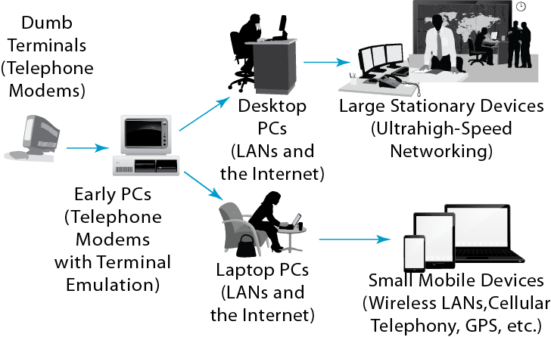
11.3: Client Evolution

Slide 9
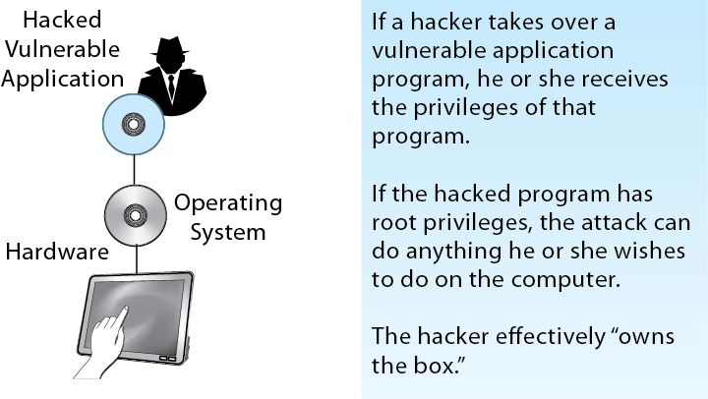
11.4: Application Hacking

Slide 10
Terminal-Host v Client/Server Processing
E-Mail
Voice over IP
HTTP and HTML
Peer-to-Peer (P2P) Applications

Slide 11
11.4: E-Mail
Importance of E-Mail
Universal service on the Internet
Attachments deliver files
Security
A major vector for attacks
Viruses and worms
Spear phishing

Slide 12
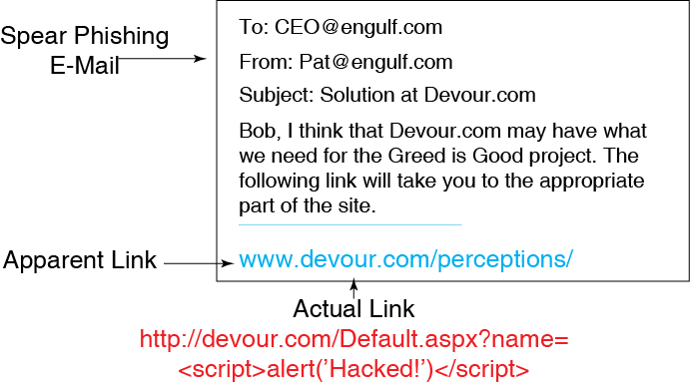
11.5: Cross-Site Scripting (XSS)

Slide 13
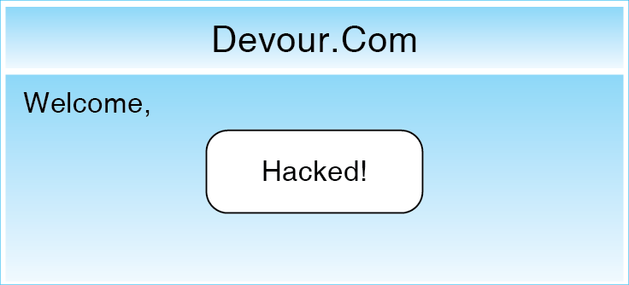
11.5: Cross-Site Scripting (XSS)
When the webpage loads, the user’s “name” is entered into the page’s HTML). However, what appears on the webpage is the script, which the browser executes

Slide 14
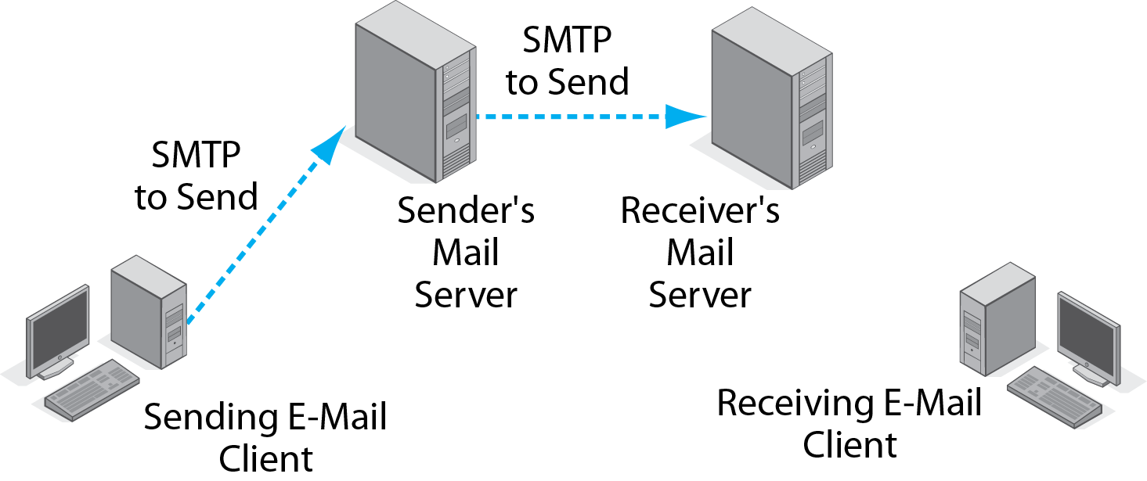
11.5: E-Mail Standards
1.
Each client PC has its own mail server.
2.
Simple Mail Transfer Protocol
for nearly instantaneous delivery

Slide 15
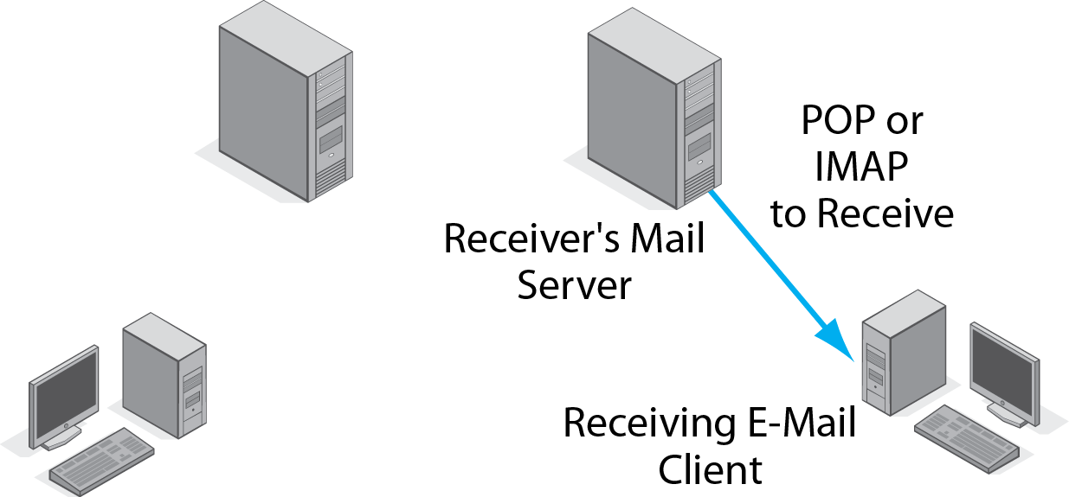
11.5: E-Mail Standards
Post Office Protocol or Internet Message Access Protocol, for later receiver downloading

Slide 16
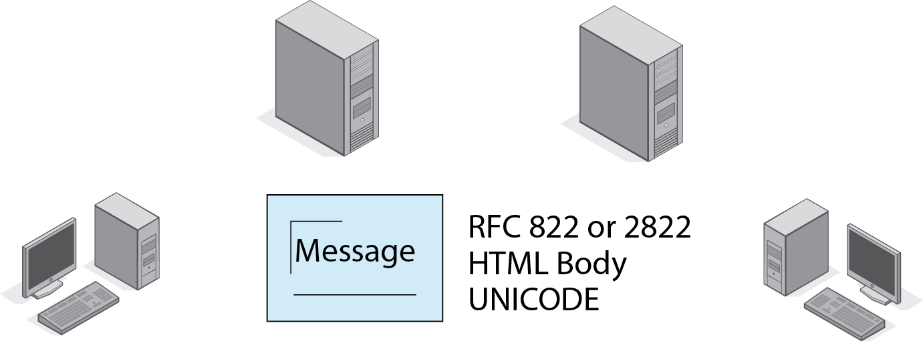
11.5: E-Mail Standards
There are separate transmission and document standards.
Document standards:
RFC 822/2822 for plain text messages.
HTML bodies for formatting.
UNICODE can represent text in any language.

Slide 17
11.5: E-Mail Standards
Many applications have two types of standards.
Delivery standards
SMTP, POP, IMAP
Message format standards
RFC 822/2822, HTML, UNICODE
It does no good to deliver messages if the receiver cannot understand them.

Slide 18



11.8: Web-Based E-Mail
Either or both clients can use web-based e-mail instead of SMTP and POP or IMAP.
All interactions for that client take place via HTTP instead.
Message documents are HTML webpages.
POP/ IMAP
HTML
HTTP
SMTP

Slide 19
11.7: Simple Mail Transfer Protocol (SMTP)
SMTP Process | Command | Explanation
Receiver | 220 mail.panko.com Ready | When the sending host establishes a TCP session, the receiver signals that it is ready.
Sender | HELO voyager.shilder.hawaii.edu | Sender indicates that it wishes to communicate.
Receiver | 250 mail.panko.com | Receiver signals it is ready to begin message.

Slide 20
11.7: Simple Mail Transfer Protocol (SMTP)
SMTP Process | Command | Explanation
Sender | MAIL FROM david@voyager.shidler.hawaii.edu | Sender identifies the mail author.
Receiver | 250 OK | Receiver signals that will accept a message from this person.

Slide 21
11.7: Simple Mail Transfer Protocol (SMTP)
SMTP Process | Command | Explanation
Sender | RCTP TO: ray@panko.com | Sender identifies a recipient.
Receiver | 250 OK | Receiver will accept mail for this recipient.

Slide 22
11.7: Simple Mail Transfer Protocol (SMTP)
SMTP Process | Command | Explanation
Sender | RCTP TO: lee@panko.com | Sender identifies a recipient.
Receiver | 550 No such user here | Receiver will NOT accept mail for this recipient.

Slide 23
11.7: Simple Mail Transfer Protocol (SMTP)
SMTP Process | Command | Explanation
Sender | DATA | Message will follow.
Receiver | 354 Start mail input; end with <CRLF> <CRLF> | Permission to send the message body.

Slide 24
11.7: Simple Mail Transfer Protocol (SMTP)
SMTP Process | Command | Explanation
Sender | When in the course… | Sends the body, which ends with a blank line.
Receiver | 250 OK | Accepts the body.

Slide 25
11.7: Simple Mail Transfer Protocol (SMTP)
SMTP Process | Command | Explanation
Sender | QUIT | Ending the connection.
Receiver | 221 mail.panko.com Service closing transmission channel | Receiver terminates the session.

Slide 26
11.9: E-Mail
Viruses, Worms, and Trojan Horses
Widespread problems; often delivered through e-mail attachments
Use of antivirus software is almost universal, but only partially effective, given the number of malware infections.
“Antivirus” programs are not limited to viruses. They scan for many types of malware.

Slide 27
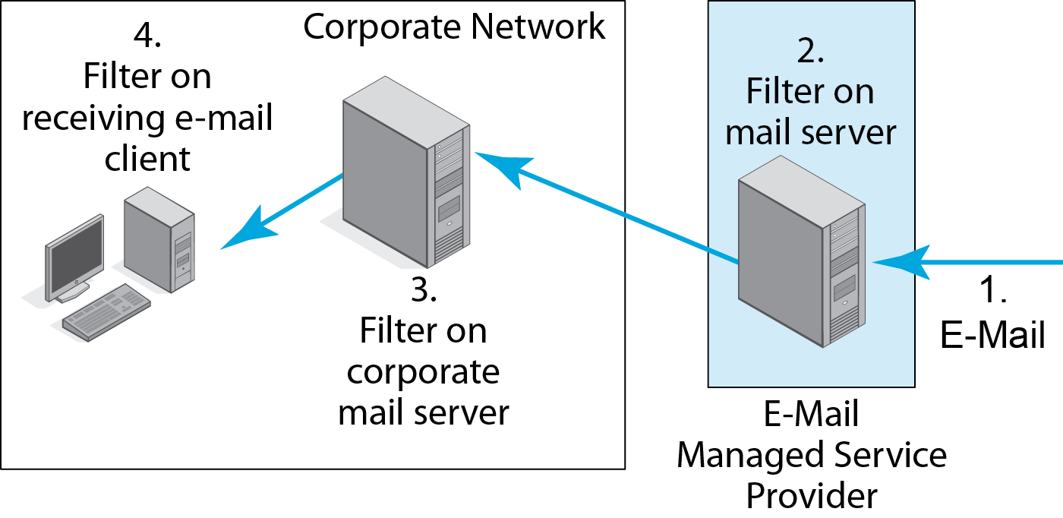
11.9: Scanning Locations for E-Mail
Filtering in two or more locations gives defense in depth.

Slide 28
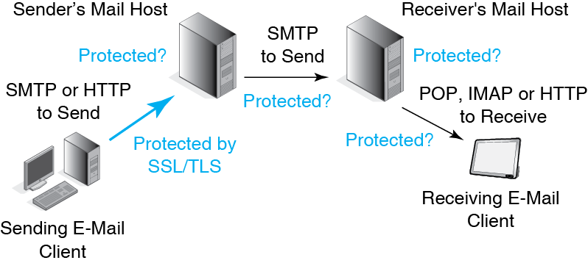
11.10: Encryption for Confidentiality
Even if the sender uses SSL/TLS, only the link to its mail host is directly secured.

Slide 29
11.10: Encryption for Confidentiality
SSL/TLS only provides link encryption. Mail servers decrypt and handle before reencrypting if they reencrypt at all

Slide 30
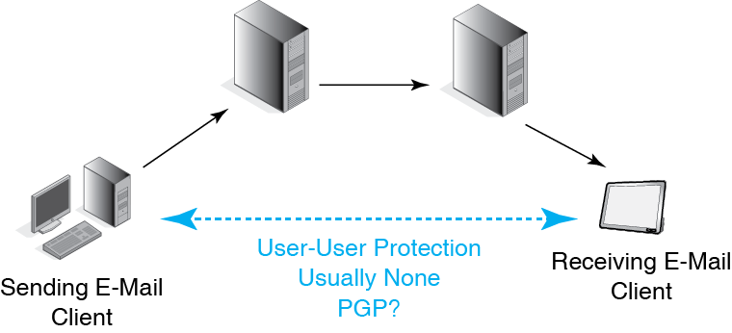
11.10: Encryption for Confidentiality
End-to-end encryption is possible.
It is done by the two hosts.
However, it is rarely done.
It prevents firewall filtering of the message.

Slide 31
Terminal-Host v Client/Server Processing
E-Mail
Voice over IP
HTTP and HTML
Peer-to-Peer (P2P) Applications

Slide 32
Voice over IP
Transmit voice telephone calls over IP networks
Saves money because the company does not have to maintain separate internal voice and data networks
Saves money because the voice signal is compressed as it is digitized

Slide 33
VoIP Signaling and Transport
Signaling versus Transport
A core concept in telecommunications
Telephony and video
Signaling
Setting up a connection, breaking it down afterward, billing, and so on
Transport
The actual transmission of voice or video

Slide 34
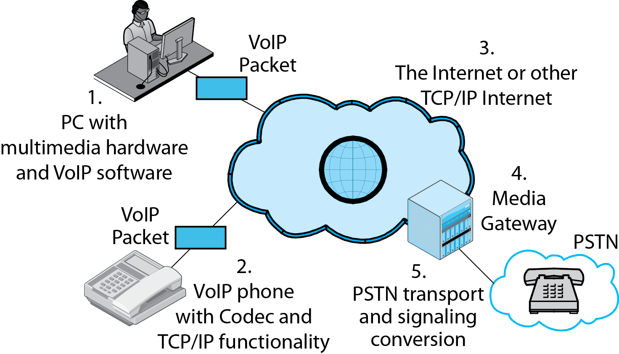
11.11: Voice over IP (VoIP)
Multimedia PC or
VoIP telephone that plugs into an IP network (Internet)

Slide 35
11.11: Voice over IP (VoIP)
Media gateway connects an IP network to the Public Switched Telephone Network.
Handles both transport and signaling conversion.

Slide 36
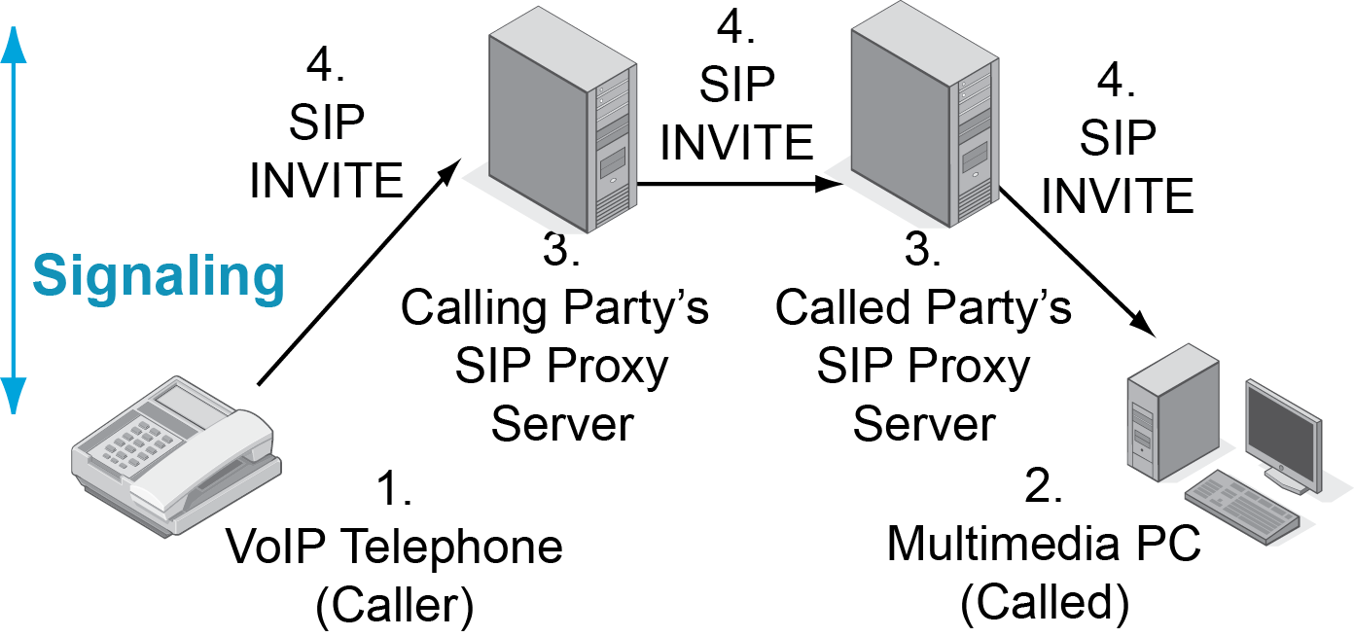
11.12: VoIP Signaling and Transport
SIP is a signaling protocol.
This figures shows connection establishment.

Slide 37
11.12: VoIP Signaling and Transport
Session Initiation Protocol Signaling Standard
Not just for initiating connections
Opens connections
Closes connections
Handles charges and bookkeeping
In other words, ALL signaling tasks

Slide 38
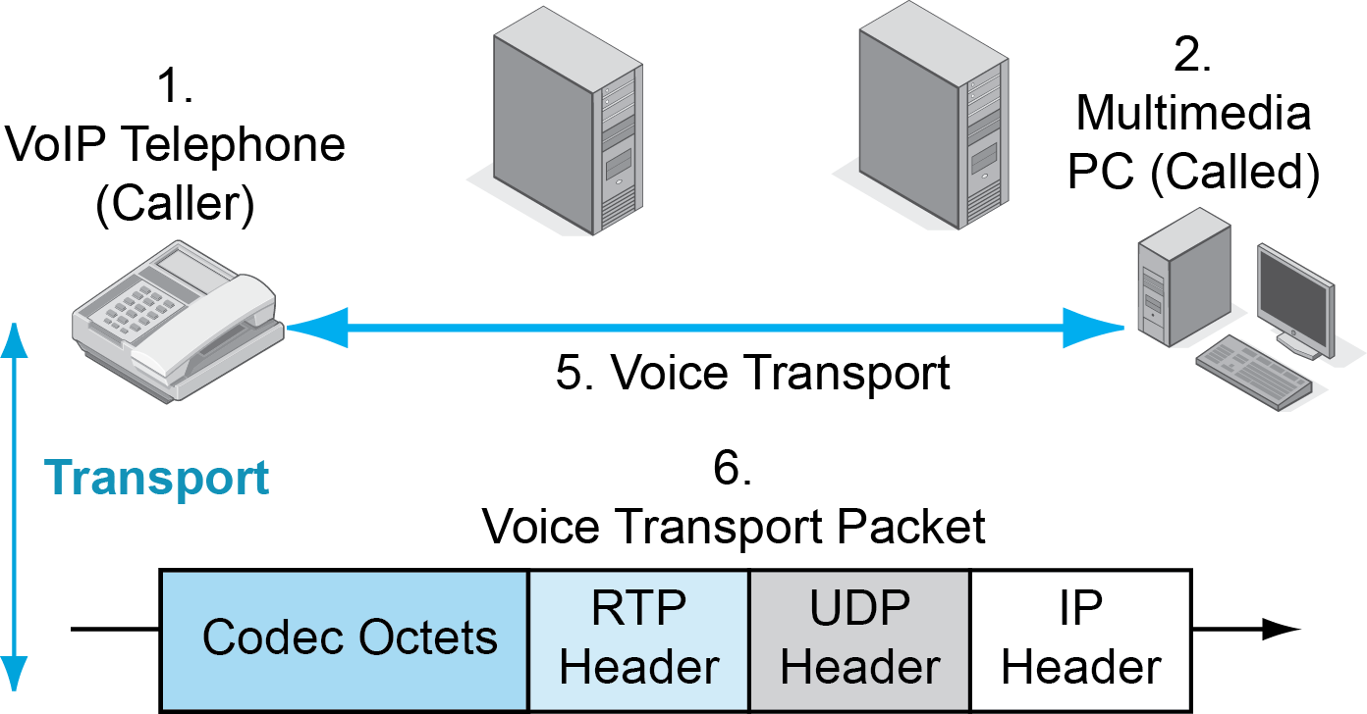
11.12: VoIP Signaling and Transport
Transport takes place directly between the caller and called party.

Slide 39
11.12: VoIP Signaling and Transport
UDP
There is no time to wait for the transmission of lost packets.
UDP makes more sense because of its lightweight processing and traffic volume requirements.
Real-Time Protocol (RTP) Header
Makes up for two UDP limits.
It adds sequence numbers.
It adds a time stamp for when its codec octets should be played back.

Slide 40
11.13: Codecs
Codecs translate analog voice to digital transmission signals.
Codec Transmission Rate
G.711 64 kbps (initial telephony standard)
G.722 48, 56, 64 kbps
G.721 32 kbps
G.722.1 24, 32 kbps
G.726 16, 24, 32, 40 kbps
G.728 16 kbps
G.729AB 8 kbps
G.723 5.33, 6.4 kbps
G.723.1A 5.3, 6.3 kbps
In general, greater compression means poorer sound quality.

Slide 41
Terminal-Host v Client/Server Processing
E-Mail
Voice over IP
HTTP and HTML
Peer-to-Peer (P2P) Applications

Slide 42
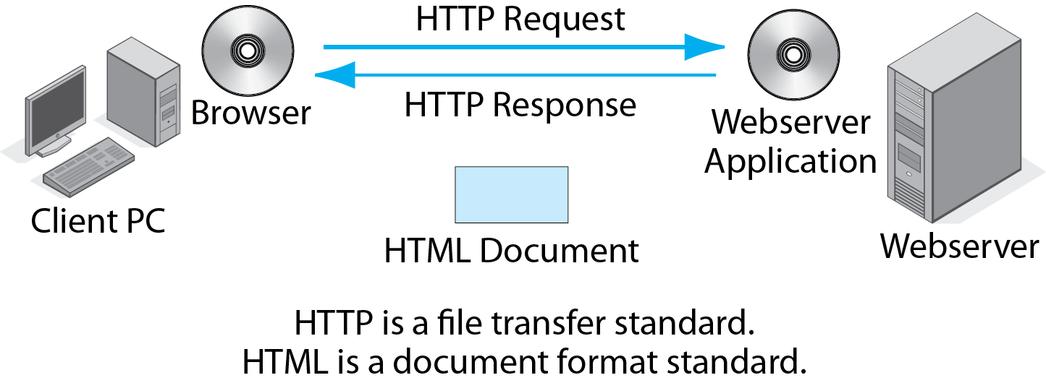
11.14: HTTP and HTML
Again, we see an application with transmission and document standards.

Slide 43
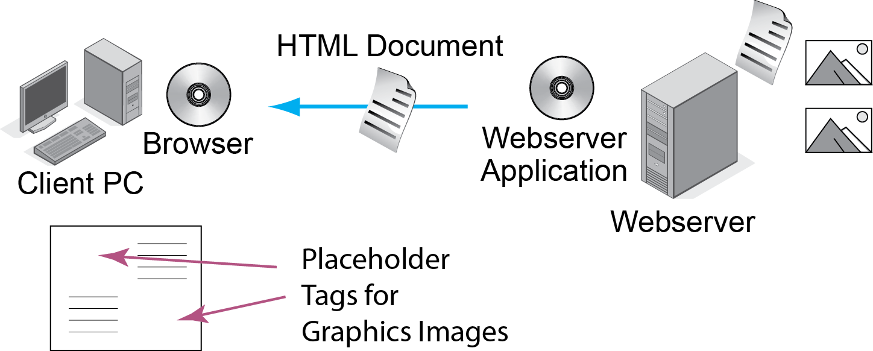
11.15: Downloading a Complex Webpage
This webpage has text and two graphics. The HTML file has the text and tags for the graphics.

Slide 44
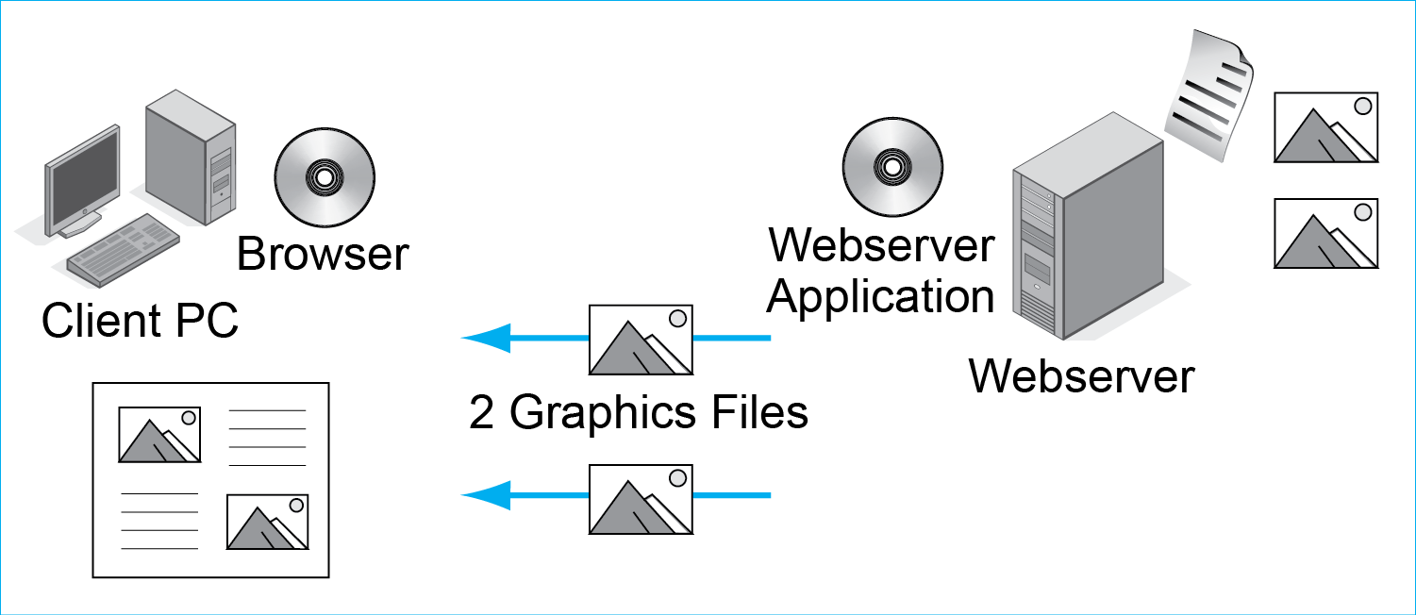
11.15: Downloading a Complex Webpage
Based on tags in the HTML file, the graphics files are downloaded and rendered on the page.

Slide 45
11.15: Downloading a Complex Webpage
Question: How many files will a browser have to download if the webpage has three graphics and plays music when it is downloaded?

Slide 46
Terminal-Host v Client/Server Processing
E-Mail
Voice over IP
HTTP and HTML
Peer-to-Peer (P2P) Applications

Slide 47

Peer-to-Peer (P2P) Architectures
Clients provide services to other clients.
Servers are not used or are used only for secondary tasks such as helping a client find another client.
Made possible by growing desktop processing power
Terminal-Host: no desktop processing power
Client/server: some desktop processing power
P2P: extensive desktop processing power

Slide 48
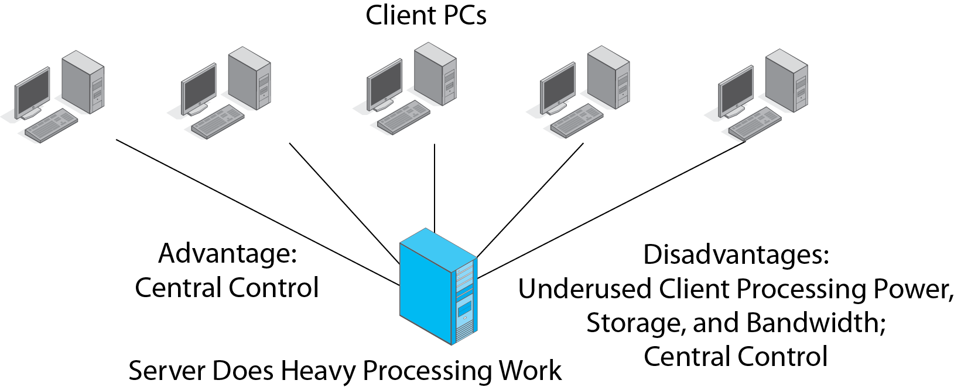
11.16: Traditional Client/Server Application

Slide 49
11.16: Traditional Client/Server Application

Slide 50
11.16: Traditional Client/Server Application

Slide 51
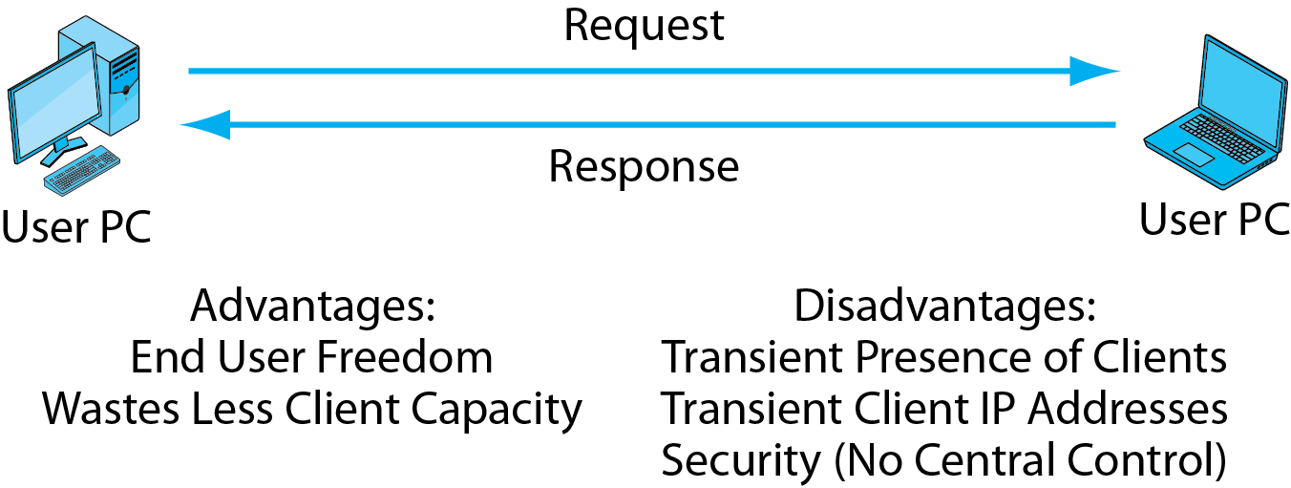
11.17: Simple Peer-to-Peer (P2P) Application

Slide 52
11.17: Simple Peer-to-Peer (P2P) Application

Slide 53
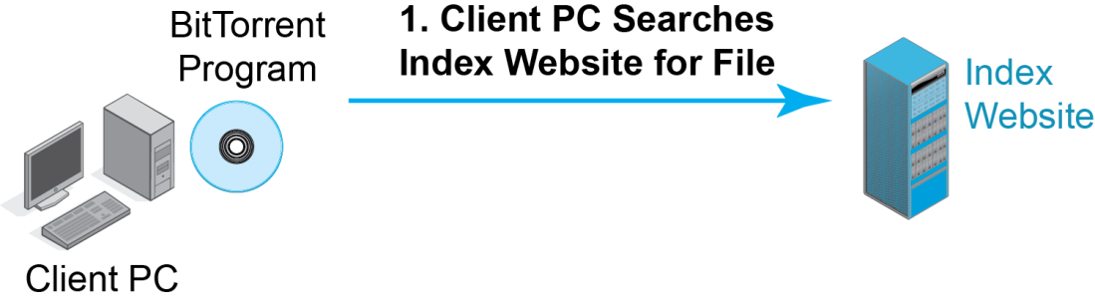
11.18: BitTorrent Protocol for P2P File Sharing
BitTorrent is a sophisticated PC file sharing standard.
The client first contacts an index webserver with a file request.

Slide 54
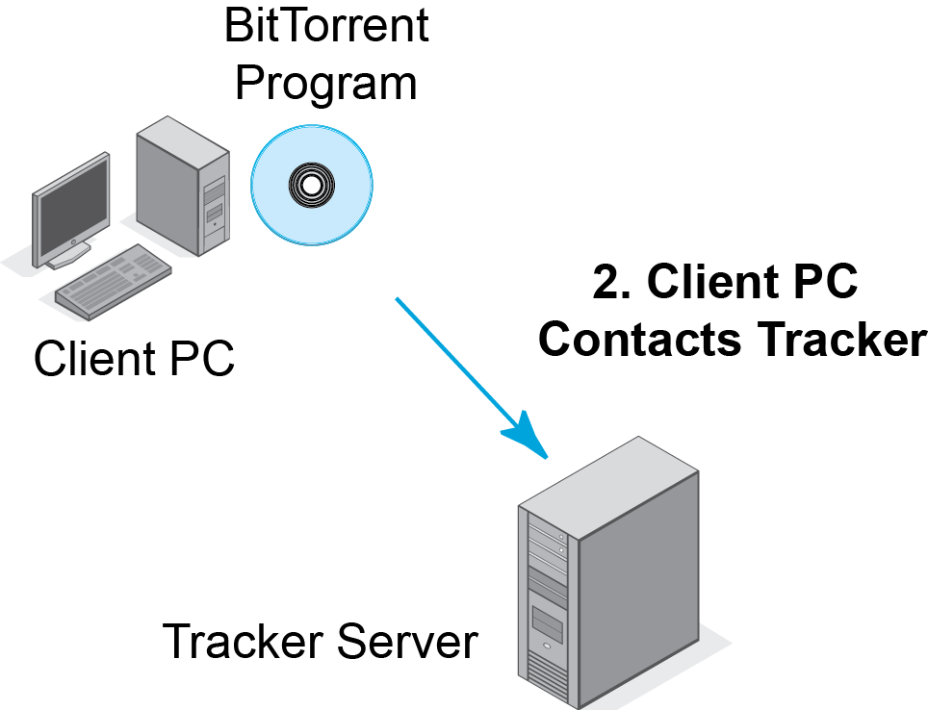
11.18: BitTorrent Protocol for P2P File Sharing
The index server directs the client to a tracker server.

Slide 55
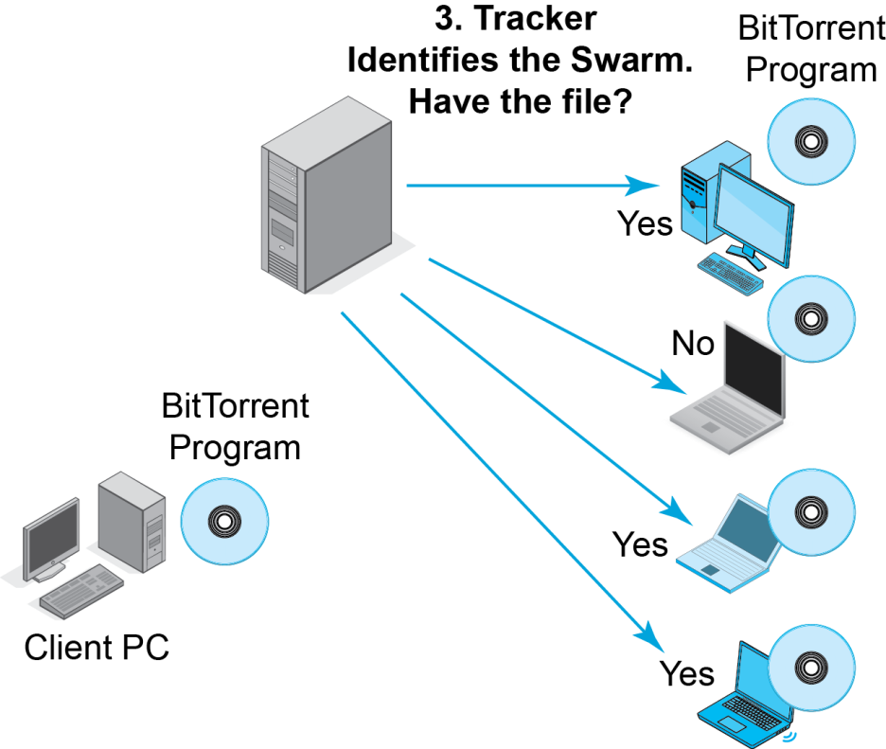
11.18: BitTorrent Protocol for P2P File Sharing
The swarm consists of client PCs that have parts of the desired file.

Slide 56
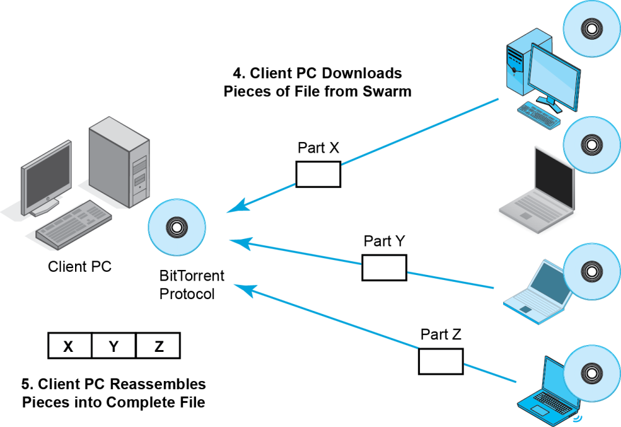
11.18: BitTorrent Protocol for P2P File Sharing
4. Client PC downloads pieces from the swarm.
5. Client PC reassembles the file.

Slide 57
11.18: BitTorrent Protocol for P2P File Sharing
Question: What do you think is the advantage of downloading the file from multiple sources instead of a single source?

Slide 58
Skype
Description and Main Features
P2P VoIP service
Very popular due to low costs
Free calling among Skype customers (computer-to-computer)
Reduced-cost calling to and from Public Switched Telephone Network customers

Slide 59
Skype
Recap
Signaling versus Transport
Signaling
Supervisory communication
Set up connection, break down connection
Billing, and so on
Transport
The actual carriage of voice signals between the caller and the called party

Slide 60
Skype
How Skype Works
Skype Network
Skype login server: the only centralized component in the Skype network
Host node: a Skype application that runs on a user’s computer
Super node: a host node that takes on the work of signaling

Slide 61
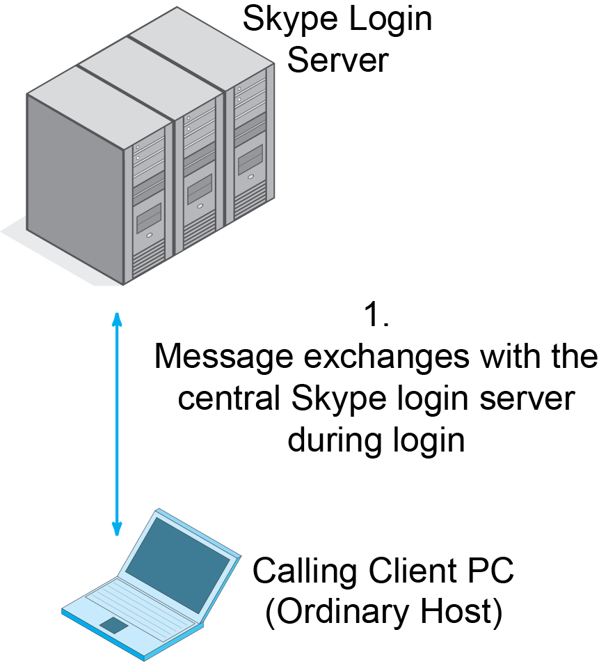
11.19: Skype Network Operation
Users must log into the network before they receive service.

Slide 62
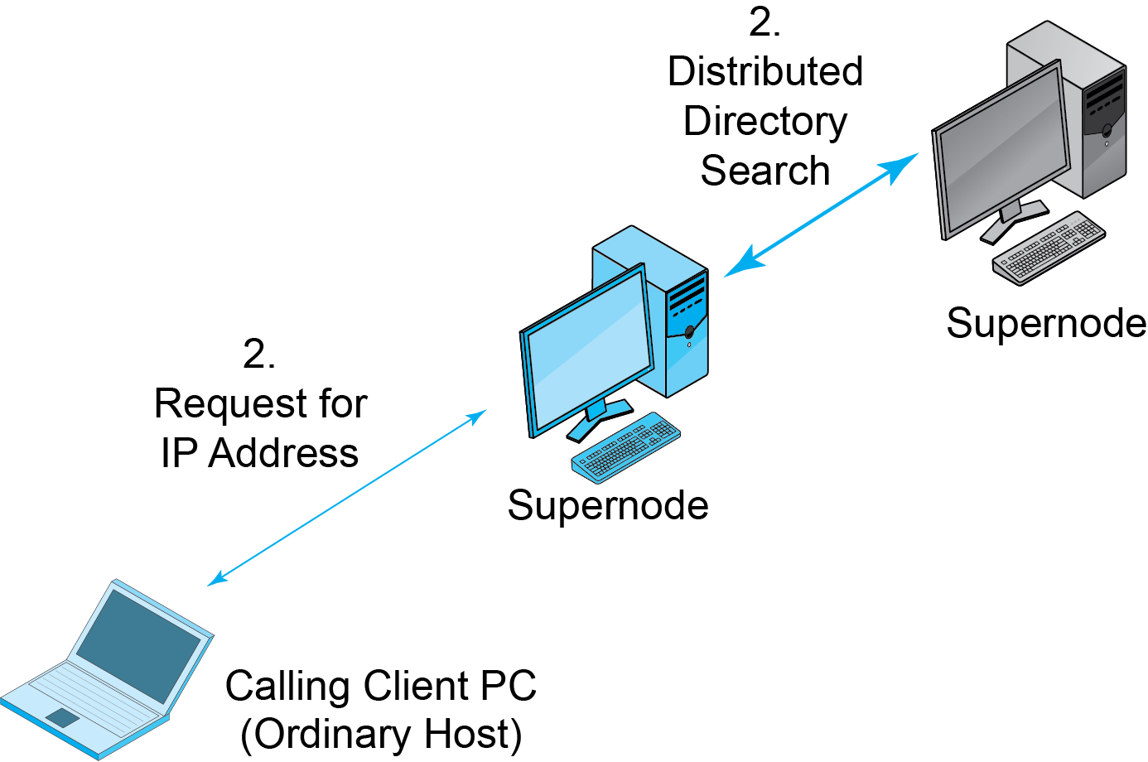
11.19: Skype Network Operation
Call set-up signaling is done P2P via supernodes, which are powerful user computers.
Powerful clients automatically become supernodes.

Slide 63
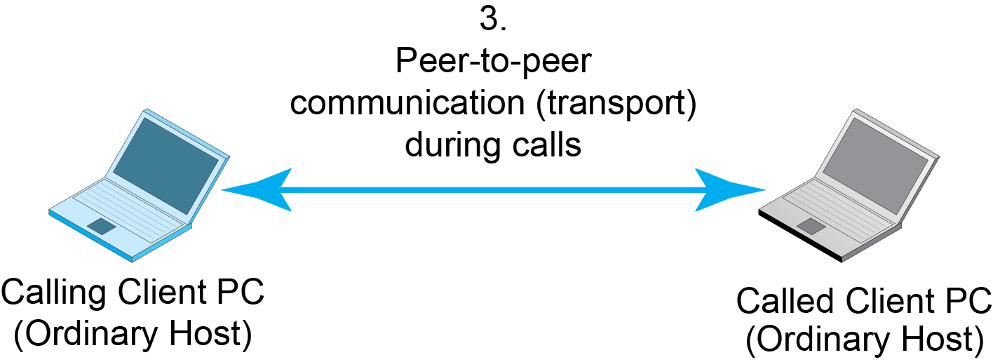
11.19: Skype Network Operation
Once connected, signaling ends
The two parties communicate entirely via P2P.
This is transport.
So most transmission is P2P.

Slide 64
11.20: Skype vs Traditional VoIP
Stage | Skype | Traditional VoIP
Registration | Server-based | Server-based
Signaling | P2P | Server-based
Transport | P2P | P2P
Skype differs from traditional P2P only in signaling.
Signaling costs are borne by Supernodes

Slide 65
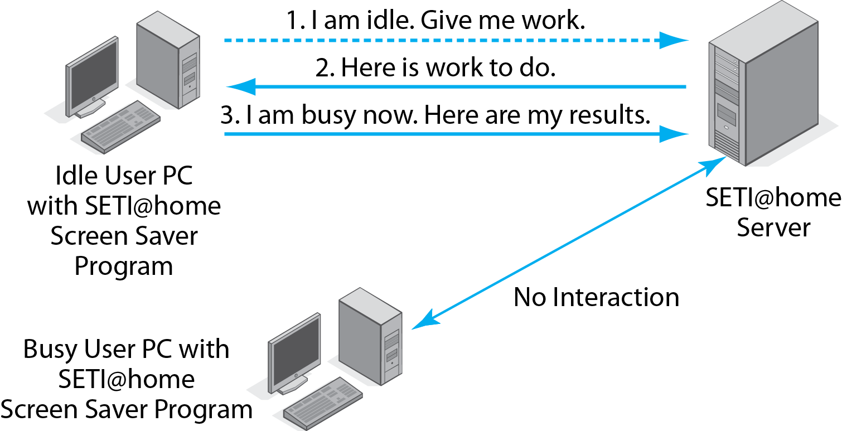
11.21 SETI@home Processor Sharing
SETI@home uses idle PC processing power.

Slide 66
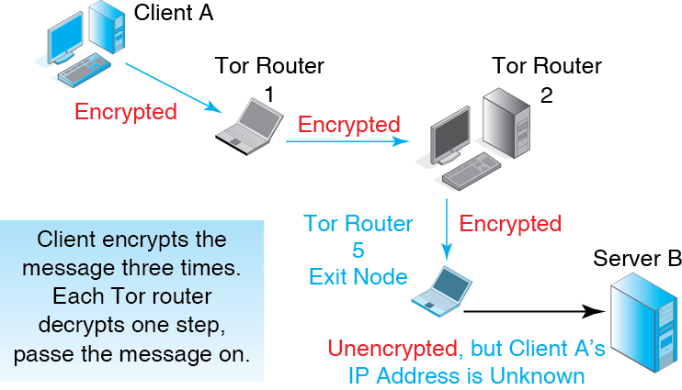
11-22: Tor for P2P Anonymity

Slide 67
P2P in Perspective
Possible because of growing client power
Types
File sharing
Communication
Processor sharing
Anonymity
…
Potential cost savings by using idle PC resources
Management and security issues

Slide 68
Terminal-Host v Client/Server Processing
E-Mail
Voice over IP
HTTP and HTML
Peer-to-Peer (P2P) Architecture

Slide 69
